Slide 1
The Culture Map
Training from the book by Erin Meyer

Slide 2


The Culture Map
Erin Meyer, https://erinmeyer.com/
Notes:
There are subtle differences in communication patterns from one culture to another. What is considered good business or common sense and the complex variations associated with them, have a tremendous impact on how we understand one another, and ultimately, how we get the job done.
Erin Meyer, in her book “The Culture Map,” helps decode the how cultural differences impact international business. She offers practical, actionable advice for working in a global world.
A little about Erin. She is a professor at INSEAD, one of the leading international business schools. Her work focuses on how the world's most successful managers navigate the complexities of cultural differences in a global environment. She helps companies to develop organizational cultures that breed both flexibility and innovation, and offers cutting-edge strategies to improve the effectiveness of projects that span the globe.

Slide 3
Purpose
The Culture Map
Learn about the invisible boundaries that divide our world
Learn about the eight scales that map the world’s cultures
Learn how to work with cultures
Notes:
In this presentation, you will learn about the invisible boundaries that divide our world. Boundaries that are as simple as how we communicate, or more complex - like how we trust.
You will learn about Erin’s eight scales that map the world’s cultures, and how being aware of our differences and similarities can help us learn how to work with other cultures.

Slide 4

The Culture Map
Notes:
Before we get into The Culture Map, let’s hear from Erin.
Presenter note: Click on video to watch.

Slide 5
Agenda
The Culture Map
Communicating
Evaluating
Persuading
Leading
Deciding
Trusting
Disagreeing
Scheduling
Conclusion
Notes:
Erin mentioned the eight different dimensions she uses to break down the nuances of dealing with other cultures. They are:
Communicating
Evaluating
Persuading
Leading
Deciding
Trusting
Disagreeing
Scheduling
Conclusion
We are going to go over each one. Let’s start with Communication.

Slide 6
Communicating
Notes:
How do you communicate with others? Do you say exactly what you mean or are you more subtle? What is the context of your communication?

Slide 7

Styles of communication
Communicating
Low-context
High-context
Notes:
There are two kinds of context to consider when communicating across cultures - low-context and high-context. Let’s start with low-context cultures.

Slide 8



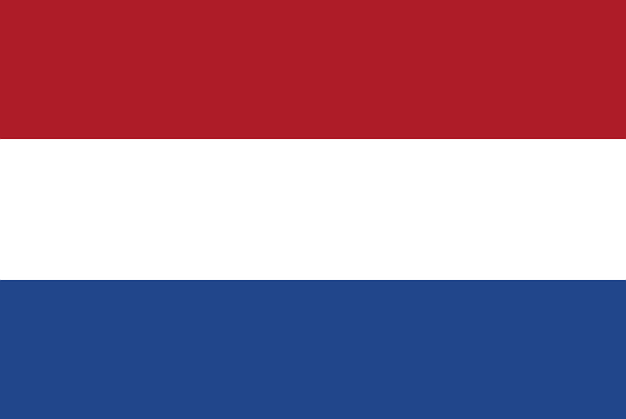
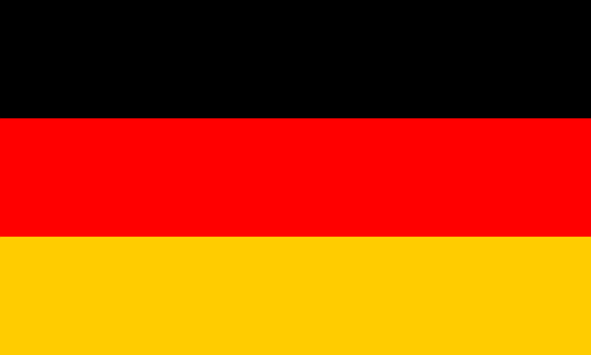

Low-context
Communicating
Precise
Simple
Clear
Face value
Repeat
United States
Canada
Australia
Netherlands
Germany
United Kingdom
Notes:
For low-context cultures, communication is precise, simple, and clear. Messages are expressed and understood at face value - people say what they mean. Repetition is appreciated if it helps clarify the message.
Presenter note: click for flag
The most low-context culture is the United States.
Presenter note: click for flag then repeat after each flag. It ends at the United Kingdom.
Other low-context cultures include: Canada, Australia, The Netherlands, Germany, and the United Kingdom.

Slide 9
Low-context
Communicating
Be transparent
Clear
Specific
Key points
Ask
Notes:
When working with low-context cultures it is best to be transparent, clear, and as specific as possible. At the end of meetings, go over what the key points from the meeting, or send an email with a summary. And ask if people understand what needs to be done.

Slide 10
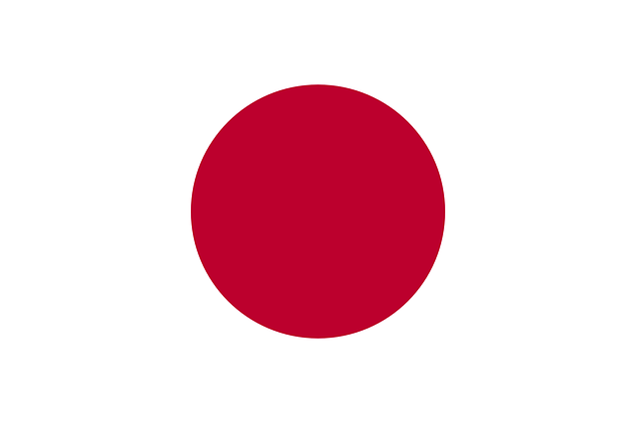
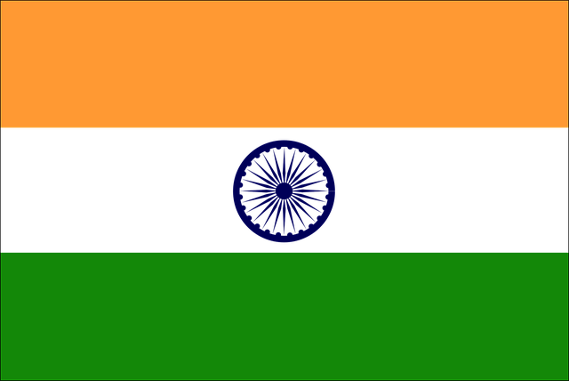




High-context
Communicating
Unconscious assumptions
Shared knowledge
Multiple interpretations
Japan
India
China
Kenya
Saudi Arabia
Indonesia
Notes:
For high-context cultures, communication depends on assumptions about common reference points and shared knowledge. It is like a couple who has been married for years. They can use fewer words to communicate because they have been together for so long and can almost read each other’s minds. High-context cultures have been around for centuries, and have a long, shared history.
Presenter note: click for flag
Japan, for example, the most high-context culture, is composed of islands with a homogenous population that for years was closed off from the rest of the world.
Presenter note: click for flag then repeat after each flag. It ends at Indonesia.
Other high-context cultures include: India, China, Kenya, Saudi Arabia, and Indonesia.

Slide 11
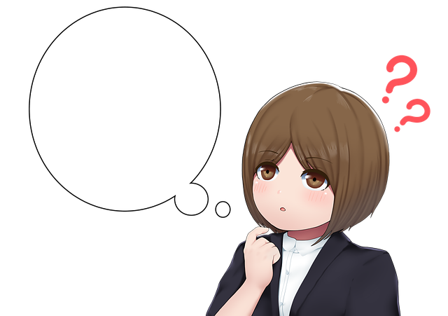
High-context
Communicating
Tomorrow
Kal =
Yesterday
Notes:
Also, in theses cultures, a large percentage of words can be interpreted multiple ways.
Presenter note: Click
For example, in Hindi, the word “kal” means Presenter note: Click
Tomorrow
Presenter note: Click
But it can also mean yesterday. It depends on the context.

Slide 12
High-context
Communicating
Listen carefully
Ask
Body language
Notes:
When working with high-context cultures, it is best to practice listening more carefully, ask clarifying questions, and be more receptive to body language.

Slide 13
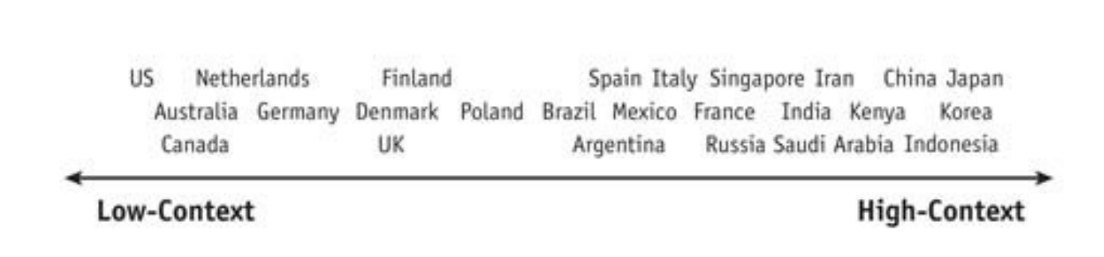
Low and High-Context
Communicating
Figure 1.1. Communicating. The Culture Map (p. 39), by Erin Meyer, 2014, New York: PublicAffairs.
Notes:
Just because two cultures are considered low or high context does not mean that they communicate the same. A person in the Netherlands is considered a higher-context communicator than one in the US. Whereas someone in Japan is a higher-context communicator than someone in India.

Slide 14
Activity - Low and High-Context
Communicating
Which of the three would lead to the most misunderstanding?
Low-context to low-context communication? Example: A Dutchman communicating with a Canadian.
High-context to low-context communication? Example: A person from China communicating with an American.
High-context to high-context communication from different cultures? Example: A person from Japan communicating with a Brazilian.
Notes:
Here is an exercise. Which of the three scenarios would leave to the most misunderstanding?
Low-context to low-context communication? For example: A Dutchman communicating with a Canadian?
High-context to low-context communication? For example: A person from China communicating with an American?
High-context to high-context communication from different cultures? For example: A person from Japan communicating with a Brazilian?
Thoughts?
Presenter note: Let the participants talk about it and share their reasons why. When the discussion has ended, click for the answer.

Slide 15
Activity - Low and High-Context
Communicating
Which of the three would lead to the most misunderstanding?
Low-context to low-context communication? Example: A Dutchman communicating with a Canadian.
High-context to low-context communication? Example: A person from China communicating with an American.
High-context to high-context communication from different cultures? Example: A person from Japan communicating with a Brazilian.
Notes:
The answer is 3 - High-context to high-context communication from different cultures.
Most misunderstanding comes from high-context to high-context where the cultures have entirely different roots. In these cases, it is a good idea to have the two groups meet and come up with ground rules for meetings and communication ahead of time. One person may summarize the key points, another communicates what is to be done next, and yet another sends a written summary. It’s a good way to make sure everyone is on the same page.

Slide 16
Summary
Communicating
Low-context
  Precise
  Simple
  Clear
  Face value
  Repeat
High-context
  Unconscious assumptions
  Shared knowledge
  Multiple interpretations
Notes:
In this module, we learned about low and high context cultures.
For low-context cultures, communication is precise, simple, and clear. Messages are expressed and understood at face value. Repetition is appreciated if it helps clarify the message.
For high-context cultures, communication depends on assumptions and shared knowledge. Also, in theses cultures, a large percentage of words can be interpreted multiple ways.

Slide 17
Evaluating
Notes:
When it comes to evaluating and giving negative feedback, what is acceptable in one culture may not be in another. Some cultures are very blunt, while others like to soften the message.

Slide 18

Evaluating types
Evaluating
Upgraders
Downgraders
Notes:
There are two cultural feedback types for evaluation - upgraders and downgraders. Let’s learn about the differences between the two.

Slide 19
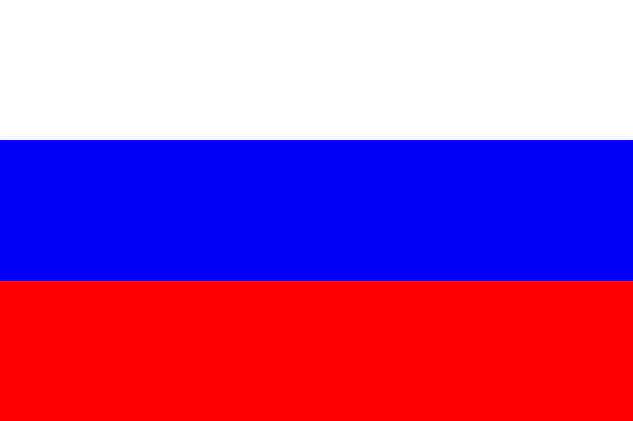

Upgraders
Evaluating
Direct
Stronger feedback
  “Totally”
  “Strongly”
  “Absolutely”
Russia
Israel
Netherlands
Germany
Notes:
Upgrading language is used by more direct cultures. They give stronger feedback by using words like “totally,” “strongly,” and “absolutely.” For example, they will use phrases like “This is totally unacceptable.”
Cultures that are upgraders include Russia,
Presenter note: click for flag then repeat after each flag. It ends at Germany.
Israel, the Netherlands, and Germany.

Slide 20
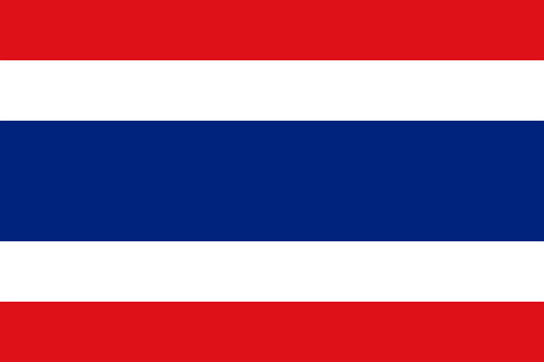
Downgraders
Evaluating
Indirect
Softer
  “Sort of”
  “Kind of”
  “Maybe”
Japan
Thailand
Indonesia
Saudi Arabia
Notes:
Downgraders, on the other hand are indirect. They soften criticism by using phrases like “sort of,” “kind of,” and “maybe.” For example, when communicating that a project needs more work, they may say something like “We are not quite there yet.”
Cultures that are upgraders include Japan,
Presenter note: click for flag then repeat after each flag. It ends at Germany.
Thailand, Indonesia, and Saudi Arabia.

Slide 21
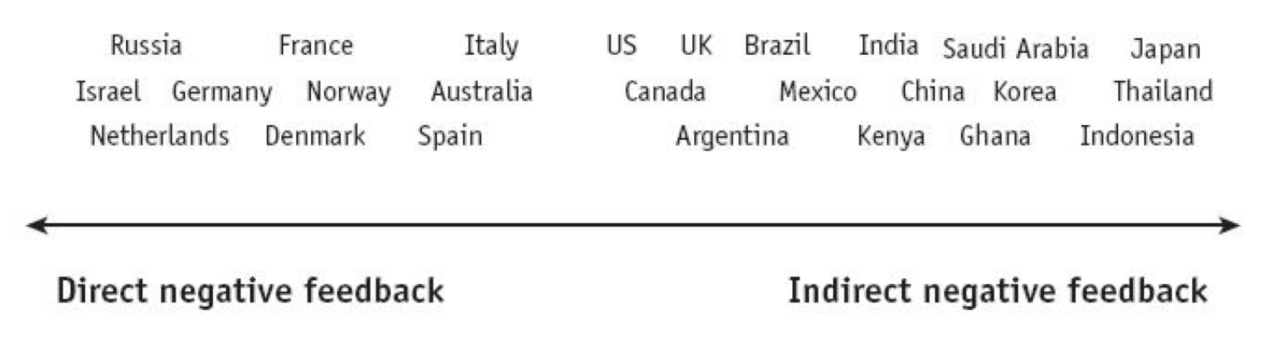
Upgraders and Downgraders
Evaluating
Figure 2.2. Evaluating. The Culture Map (p. 69), by Erin Meyer, 2014, New York: PublicAffairs.
Notes:
Just because two cultures are considered an upgraders or downgrader does not mean they give feedback the same way. Germany is considered more of an upgrader to Spain, but are not as direct as Israel or Russia. On the other side of the scale, China is more of a downgrader than Mexico, but is more direct than Japan or Thailand.
Now let’s add what we learned about low and high context communication to direct and indirect negative feedback.

Slide 22
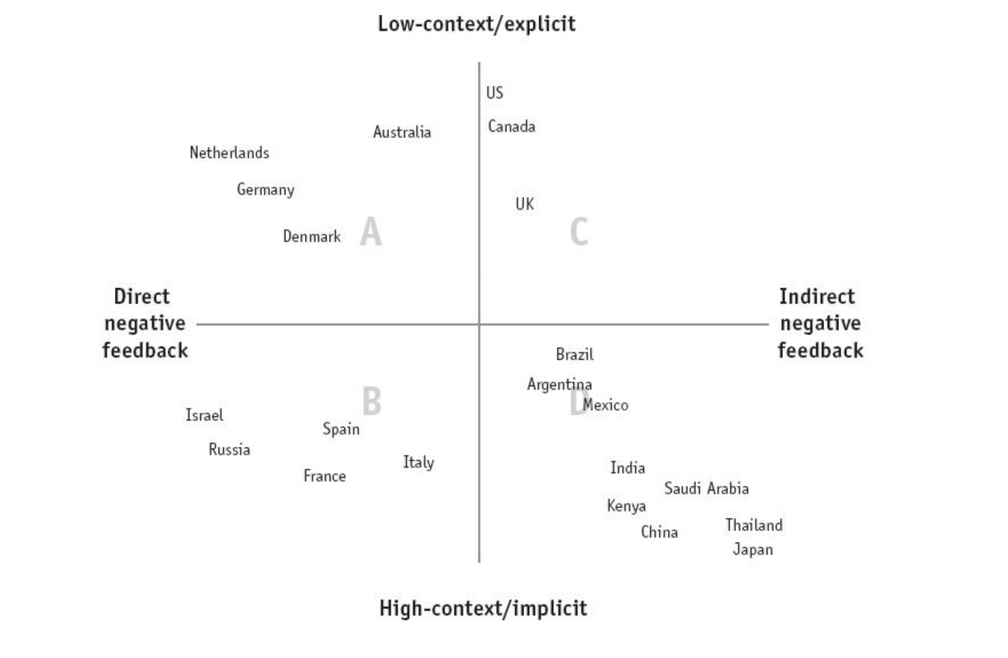
Evaluating
Figure 2.3. The Culture Map (p. 69), by Erin Meyer, 2014, New York: PublicAffairs.
Notes:
There are four groups to consider when looking at evaluating:
Group A is low-context/explicit that provides direct negative feedback.
Group B is high-context/implicit that provides direct negative feedback.
Group C is low-context/explicit that provides indirect negative feedback.
Group D is high-context/explicit that provides indirect negative feedback.
Let’s look at each group and the best way to work with each.

Slide 23
Evaluating
Figure 2.3. The Culture Map (p. 69), by Erin Meyer, 2014, New York: PublicAffairs.
Notes:
Group A, as mentioned, contains low-context/explicit cultures that provide direct negative feedback. These cultures may be considered very direct by others.
Cultures like these include the Netherlands, Germany, Denmark, and Australia.
They are honest, transparent, and respect your professionalism. This respect is why they do not hide their criticism.
When working with them, accept their direct criticism in a positive manner.

Slide 24
Evaluating
Figure 2.3. The Culture Map (p. 69), by Erin Meyer, 2014, New York: PublicAffairs.
Notes:
In group B, are the high-context/implicit cultures that provide direct negative feedback. These cultures speak between the lines and provide sharp and direct negative feedback.
Cultures like these include Israel, Russia, France, Spain, and Italy.
When working with these cultures, keep in mind that although they are more direct with those they are close to, they are more hierarchical in their communication. They may be more direct with subordinates, but more diplomatic with superiors.

Slide 25
Evaluating
Figure 2.3. The Culture Map (p. 69), by Erin Meyer, 2014, New York: PublicAffairs.
Notes:
In group C, are the low-context/explicit cultures that provide indirect negative feedback. These cultures soften negative criticism with positive messages. For example, in the United States positive feedback is usually given before negative. It can be challenging for other cultures as the feedback may seem fake.
Cultures like these include the United States, Canada, and the United Kingdom.
When working with these cultures, be explicit. Try over time to be balanced with positive and negative feedback. If your culture is more direct, try to frame your behavior in cultural terms. For example, a French person may say, “In the U.S., you are so good at openly appreciating one another. In France, we aren’t in the habit of voicing positive feedback.”

Slide 26
Evaluating
Figure 2.3. The Culture Map (p. 69), by Erin Meyer, 2014, New York: PublicAffairs.
Notes:
In group D, are the high-context/implicit cultures that provide indirect negative feedback. These cultures give negative feedback that is soft, subtle, and implicit. They are negative in private.
Cultures like these include Japan, Thailand, China, India, Saudi Arabia, Mexico, and others.
When working with these cultures, never give negative feedback in front of a group. Slowly give feedback over time.
Use food and drink to blur an unpleasant message.
Say the good and leave out the bad. By leaving out what is not working, people in these cultures will get the subtle message. For example, if a person in Kenya does well on project B, but did horribly with project A, a supervisor may say to that person, “You your work on project B was excellent.” By leaving out any mention of project A, the person knows he did not do well.

Slide 27
Evaluating
Figure 2.3. The Culture Map (p. 69), by Erin Meyer, 2014, New York: PublicAffairs.
Notes:
Here is the complete graph again.

Slide 28
Activity - Upgraders and Downgraders
Evaluating
Which is an upgrader and which is a downgrader?
Maybe you should edit this report.
The contract is absolutely necessary before we can go ahead with the project.
I strongly suggest you speak to the supervisor.
The new hire kind of needs more training.
Notes:
Let’s do an activity, Which of these sentences have upgraders and which have downgraders?
Presenter note: Let the participants talk about it and share their reasons why. When the discussion has ended, click for the answers.

Slide 29
Activity - Upgraders and Downgraders
Evaluating
Which is an upgrader and which is a downgrader?
Maybe you should edit this report. - Downgrader
The contract is absolutely necessary before we can go ahead with the project. - Upgrader
I strongly suggest you speak to the supervisor. - Upgrader
The new hire kind of needs more training. - Downgrader
Notes:
Here are the answers.
1 and 4 are downgraders. Note the use of the phrases “maybe” and “kind of.” They soften the message.
2 and 3 are upgraders with the use of “absolutely” and “strongly.” They are direct.
Any questions?

Slide 30
Summary
Evaluating
Upgraders
Downgraders
Communicating + Evaluating = Feedback
Notes:
In this module we learned about upgrading and downgrading cultures and how they use certain phrases to give feedback.
We also learned how adding low and high context communication combined with upgrading and downgrading affect how cultures give feedback.

Slide 31
Persuading
Notes:
The way you seek to persuade others, and the arguments you find persuasive, are rooted in your culture’s philosophical, religious, and educational assumptions and attitudes.

Slide 32

Styles of reasoning
Persuading
Principles-first
Applications-first
Notes:
How you persuade others in different cultures is based on their style of reasoning. Are they principles-first or applications-first?

Slide 33
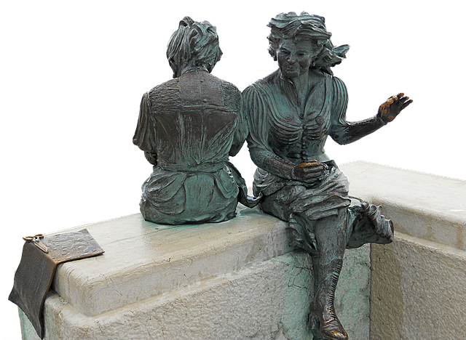


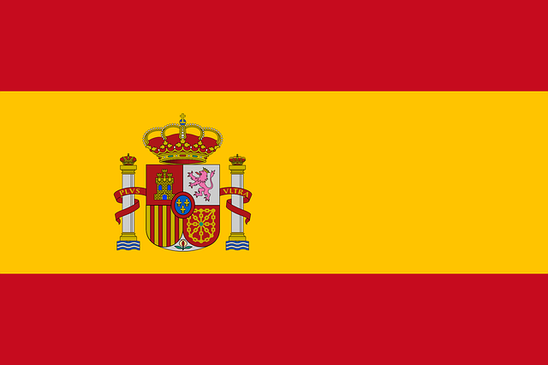
Principles-first
Persuading
Deductive reasoning
General principles or concepts
Why?
Civil Law
Explain the background
Italy
France
Russia
Spain
Notes:
Principles-first reasoning is also known as deductive reasoning. In these cultures, people get their conclusions or facts from general principles or concepts.
An example of principles-first reasoning is “Everything made of copper conducts electricity. This statue is made of copper. Therefore this statue will conduct electricity.”
A culture that is principles-first wants to understand the “why” behind a request.
The justice systems in these cultures are based on Civil Law - general statutes or principles are applied on a case by case basis.
In dealing with principles-first cultures, it is best to explain the background or data behind something before giving the conclusion.
Cultures that are principles-first include Italy,
Presenter note: click for flag then repeat after each flag. It ends at Spain.
France, Russia, and Spain.

Slide 34
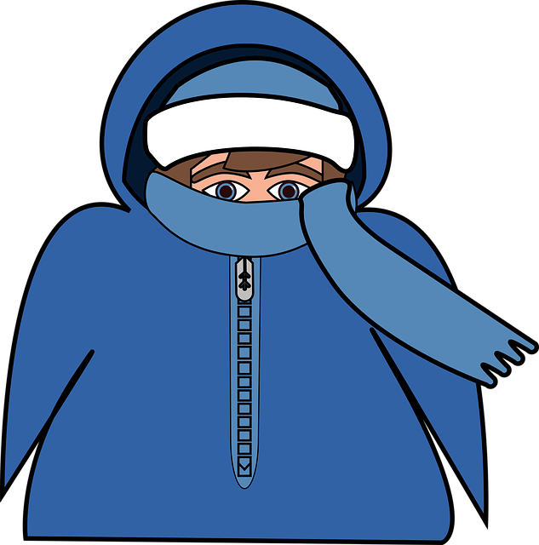

Applications-first
Persuading
Inductive reasoning
Factual observations
How
Common Law
Get to the point
United States
Canada
Australia
United Kingdom
Notes:
Applications-first reasoning is also known as inductive reasoning. In these cultures, people get their conclusions or facts based on a pattern of observations from the real world.
For example with applications-first reasoning, if you visit Minnesota in the United States 100 times in January and February, you will observe the temperatures are below zero. You will then conclude that Minnesota winters are cold.
A culture that is applications-first wants to understand the “how” behind a request.
The justice systems in these cultures are based on Common Law - judgement in one case sets the precedent for future cases.
In dealing with these cultures, it is best to get to the point.
Cultures that are applications-first include the United States,
Presenter note: click for flag then repeat after each flag. It ends at the United Kingdom.
Canada, Australia, and the United Kingdom.

Slide 35
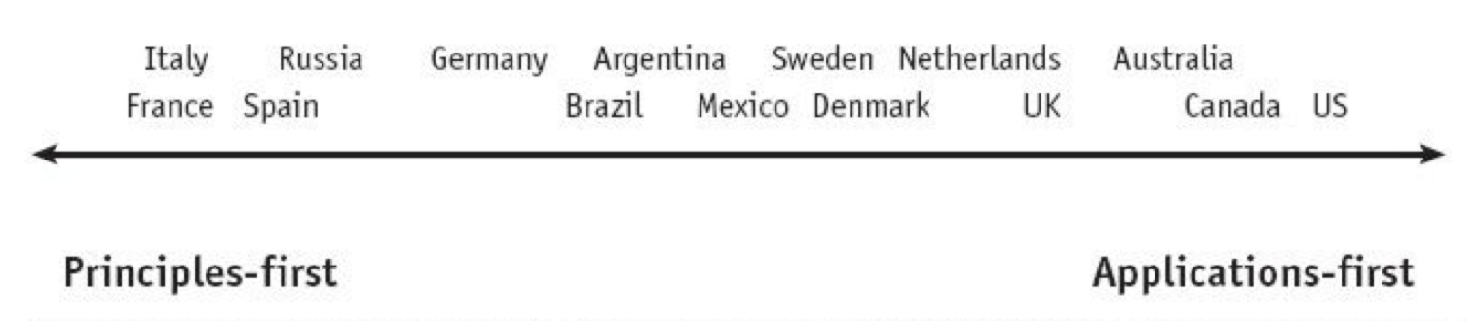
Persuading scale
Persuading
Figure 3.1. Persuading. The Culture Map (p. 96), by Erin Meyer, 2014, New York: PublicAffairs.
Explain the scale
Use a cultural bridge
Understand and adapt
Be patient and flexible
Notes:
Here are some tips for dealing with different ends of the persuading scale:
Build team awareness by explaining this scale found in “The Cultural Map.”
Use a cultural bridge through bicultural team members, or team members who have spent significant time imbedded in the other culture.
Understand and adapt to one another’s behaviors.
Most of all, be patient and flexible.

Slide 36
Holistic Thinking
Persuading
Big picture
How everything fits
Figure 3.1. Persuading. The Culture Map (p. 96), by Erin Meyer, 2014, New York: PublicAffairs.
Notes:
You may have noticed in the persuasion scale there are no East-Asian cultures listed. That is because they take a different approach. These cultures are more holistic. They look at the big picture and how all the pieces fit together.

Slide 37


Holistic Thinking
Persuading
American photograph
Japanese photograph
Notes:
Here is how holistic thinking works.
In one study Americans and Japanese were told to take a photo of a person. Please note that the photos above were not the ones used in the study.
Americans took a close up of the person while the Japanese took a photo showing the person in their environment.
American photographers focused on the face because they see that as the person. The Japanese, however, included the background to determine more about the person. They were focused on the whole picture.
In dealing with Holistic cultures, it helps to explain the big picture in detail. Outline how all of the parts are connected before getting into what specifically needs to be done.

Slide 38
Tips for Multicultural Teams
Persuading
Few people as possible work across cultures
Think about larger objectives
Notes:
Here are some tips for working with multicultural teams.
Have as few people as possible work across cultures. Use one or two of the most internationally experienced from each culture.
Think about the larger objectives before mixing up cultures. If your goal is creativity and innovation, the more culturally diverse, the better. If your goal is speed and efficiency, then monocultural is better.

Slide 39
Activity - Persuading
Persuading
What would you do to persuade someone in these cultures?
Russia
Australia
Japan
Notes:
Let’s do an activity, What would you do to persuade someone in these cultures?
Presenter note: Let the participants talk about it and share their reasons why. When the discussion has ended, click for the answers.

Slide 40
Activity - Persuading
Persuading
What would you do to persuade someone in these cultures?
Russia - Explain the why, give the data and background before the conclusion.
Australia
Japan
Notes:
Russia is a principles-first culture. So with them you would want to explain the why, and give the data and background before the conclusion.
Presenter note: Click to go to Australia’s answer.
Australia is applications first. They are going to want to know the how behind a request. It is best to get to the point with them.
Japan is holistic. Show them the big picture and how the pieces fit together.

Slide 41
Activity - Persuading
Persuading
What would you do to persuade someone in these cultures?
Russia - Explain the why, give the data and background before the conclusion.
Australia - Show the how and get to the point.
Japan
Notes:
Australia is applications first. They are going to want to know the how behind a request. It is best to get to the point with them.
Presenter note: Click to go to Japan’s answer.

Slide 42
Activity - Persuading
Persuading
What would you do to persuade someone in these cultures?
Russia - Explain the why, give the data and background before the conclusion.
Australia - Show the how and get to the point.
Japan - Show the big picture and how all the pieces fit together.
Notes:
Japan is holistic. Show them the big picture and how the pieces fit together.

Slide 43
Summary
Persuading
Principles-first
Applications-first
Holistic
Notes:
To sum up this module, a principles-first culture wants to know the “why” whereas an applications-first culture wants to know the “how.” East-Asian cultures are more holistic - they like to know the whole picture.

Slide 44
Leading
Notes:
What does a good boss look like to you? Is your boss casually dressed? Addresses everyone by their first names? Are employees empowered to make decisions without the boss’s approval?
Or is your idea of a good boss one that dresses professionally, addresses everyone formally, and makes the final decision?

Slide 45

Styles of leadership
Leading
Egalitarian
Hierarchical
Notes:
There are two cultural styles of leadership: egalitarian and hierarchical. Let’s start with egalitarian.

Slide 46



Egalitarian
Leading
Low distance
Boss is facilitator
Flat organization
Communication skips
Denmark
Netherlands
Sweden
Notes:
In an egalitarian culture, the ideal distance between a boss and subordinate is low. The best boss is a facilitator among equals. Organizational structures are flat, not top-down. Communication often skips hierarchical lines - anyone can talk to anyone else no matter their rank in the organization.
If you were to walk into a work meeting in an egalitarian culture, you would probably have a hard time picking out who was the boss. People in the meeting are casually dressed and speaking as equals.
Cultures that are egalitarian are Denmark,
Presenter note: click for flag then repeat after each flag. It ends at Sweden.
The Netherlands, and Sweden.

Slide 47
Egalitarian management
Leading
Speak with each employee
Concrete objectives
Check in
Dress the same
Minimize titles
Notes:
If you find yourself leading in an egalitarian culture:
Facilitate by speaking with each employee about the vision for the coming year. Ask them to propose their best, personal, annual objectives. These objectives are subject to final agreement from you - no matter how egalitarian they are.
Make sure objectives are concrete and specific. Consider linking them to rewards.
Set objectives for a 12 month period and check in on progress periodically. Get more involved if progress lags.
Dress as team members do.
Minimize the use of titles and address people by their first name and tell them to do the same with you.

Slide 48
Egalitarian tips
Leading
Go to the source
Don’t copy the boss
Skip levels
Use first names
Side on hierarchical
Notes:
When working with people from egalitarian cultures:
Go directly to the person you need to speak with.
Think twice before copying the boss. Doing so suggests to the recipient that you don’t trust them.
Skipping hierarchical levels shouldn’t be a problem.
Scandinavia, the Netherlands, and Australia use first names. This is MOSTLY true for the United States and the United Kingdom, but it is best to check first or follow their lead.
If you are not sure if a culture is egalitarian or not? Then follow hierarchical tips until you know for sure.
Let’s look at hierarchical cultures.

Slide 49

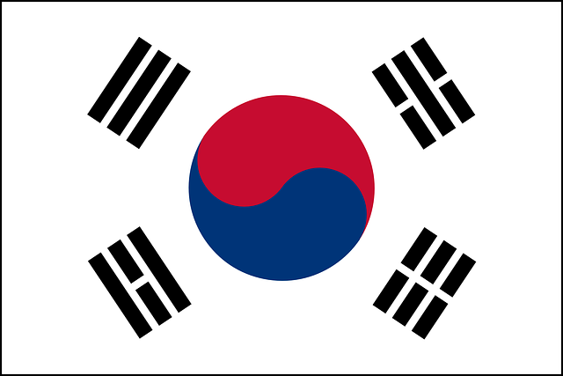

Hierarchical
Leading
High distance
Lead from the front
Status important
Fixed organization
Communication linear
Japan
South Korea
Nigeria
Notes:
In a hierarchical culture, the ideal distance between a boss and subordinate is high. The best boss is a strong leader and leads from the front. Status is important. Organizational structures are multilayered and fixed. Communication follows set hierarchical lines.
If you were to walk into a work meeting in a hierarchical culture, you would be able to spot the boss immediately. They would be dressed professionally, sitting at the head of the table, and doing most if not all of the speaking.
Cultures that are hierarchical are Japan,
Presenter note: click for flag then repeat after each flag. It ends at Nigeria.
South Korea, and Nigeria.

Slide 50
Hierarchical management
Leading
Meet without you
Give time to prepare
Chair meetings
Notes:
If you find yourself leading in a hierarchical culture:
Encourage your team to meet without you to brainstorm as a group and then report back to you. Removing the boss removes their need to defer to you.
Give clear instructions a few days before a meeting on how the meeting will work and what questions you will ask.
Remember your role is to chair meetings. In meetings invite people to speak up.

Slide 51
Hierarchical tips
Leading
Communicate at your level
Copy the boss
Get permission
Use last names
Notes:
When working with people from hierarchical cultures,
Communicate with the person at your level. If you are a assistant director, then communicate with their assistant director.
If you have to email with someone lower on the hierarchical level, copy that person’s boss on the email.
If you need to approach your boss’s boss or your subordinate’s subordinate, get permission from the person at the level in between first. For example, if you need to communicate with someone two levels higher than you in the organization, get permission from the person in between you and the person two levels higher first.
When emailing or contacting someone in a hierarchical culture, address them by their last name unless they have stated otherwise.

Slide 52
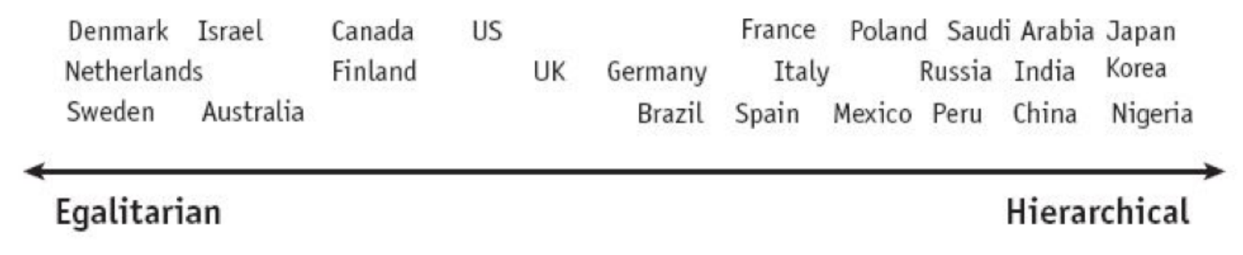
Leading scale
Leading
Figure 4.1. Leading. The Culture Map (p. 125), by Erin Meyer, 2014, New York: PublicAffairs.
Notes:
Here is a graph that shows where cultures fall on the leading scale. Like in the other scales, where cultures lie on the scale affect how they are seen by others on the scale. Israel may be egalitarian, but not as much as Sweden, but more so than Canada. Peru may be hierarchical, but not as much as Nigeria, but more than Poland.
Presenter note: Give a few seconds for participants to read.
Now let’s do a little activity.

Slide 53

Activity - Leading
Leading
Which leading type is shown in the following image?
Notes:
Looking at this image, what kind of leadership style do you think is portrayed here?
Presenter notes: Give participants time to discuss what they think. Then click to the next slide.

Slide 54
Activity - Leading
Leading
Egalitarian
No obvious boss
Casual dress
Collaboration among equals
Notes:
This is egalitarian style of leadership. There is no obvious boss. Dress is casual and they are speaking as though equals.

Slide 55

Activity - Leading
Leading
Which leading type is shown in the following image?
Notes:
Now in this image, what kind of leadership style do you think is portrayed here?
Presenter notes: Give participants time to discuss what they think. Then click to the next slide.

Slide 56
Activity - Leading
Leading
Hierarchical
Boss is obvious
Professional dress
Everyone listening to the boss
Notes:
This is a hierarchical meeting. When you walk in, the boss is at the head of the table and everyone is listening to him. Also, note that everyone is dressed professionally.

Slide 57

Activity - Leading
Leading
Which leading type is shown in the following image?
Notes:
What kind of leadership style do you think is portrayed here?
Presenter notes: Give participants time to discuss what they think. Then click to the next slide.

Slide 58
Activity - Leading
Leading
Hierarchical?
Boss is obvious
Professional dress
Notes:
You can assume this is a hierarchical meeting. When you walk in, the boss is at the head of the table. Also, note that everyone is dressed professionally. Just because the boss is smiling doesn't mean it is a egalitarian meeting - you can smile in hierarchical meetings too. Remember the rule - if you don’t know if it is egalitarian or hierarchical, side with hierarchical.

Slide 59

Activity - Leading
Leading
Which leading type is shown in the following image?
Notes:
What about this meeting? Is it hierarchical or egalitarian?
Presenter notes: Give participants time to discuss what they think. Then click to the next slide.

Slide 60
Activity - Leading
Leading
Egalitarian
No obvious boss
Casual dress
Collaboration among equals
Notes:
This one is egalitarian. Everyone is casually dressed, there is no obvious boss, and they seem to collaborating as equals.

Slide 61
Summary
Leading
Hierarchical
Egalitarian
Notes:
In this module, we learned about hierarchical and egalitarian cultures. Hierarchical is more formal while egalitarian is more relaxed. Keep in mind the differences and if you are not sure which to follow, side with hierarchical.

Slide 62
Deciding
Notes:
How do you like to decide in the workplace? Do you like to discuss and much as possible with others and then make a final decision? Or do you like to have someone else make a decision that is not permanent?

Slide 63
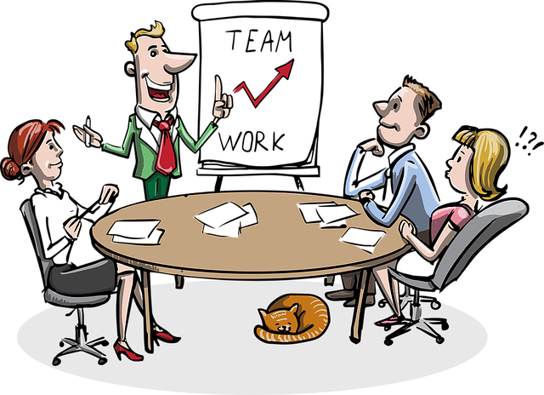
Styles of decision-making
Deciding
Consensual
Top-down
Notes:
How are decisions made in different cultures? In most cases, cultures that are egalitarian are consensus-driven whereas hierarchical cultures are top-down.

Slide 64
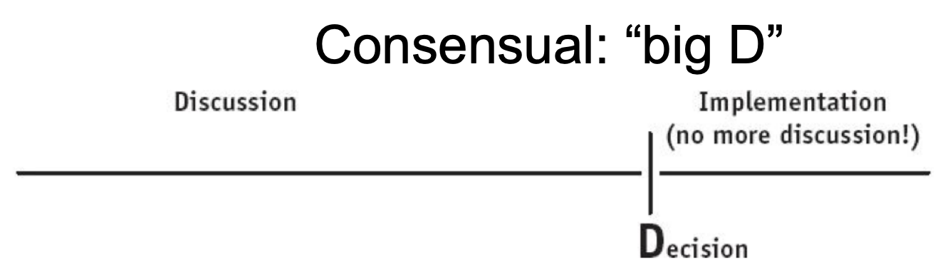
Consensual
Deciding
Discussion → Decision
Everyone consulted
Quick implementation
Japan
Netherlands
Sweden
Figure 5.1. The Culture Map (p. 149), by Erin Meyer, 2014, New York: PublicAffairs.
Notes:
In consensual cultures there is a long discussion time before a decision is made.
Presenter notes: Click to show graph
As you can see in this graph, the discussion process takes a while. Part of the reason is because everyone is consulted in the decision-making process. Once a decision is made, it is a decision with a big D - as in the decision is made, implementation is quick, and the decision is not to be changed.
Presenter notes: Click to remove graph.
Cultures that are consensual are Japan,
Presenter note: click for flag then repeat after each flag. It ends at Sweden.
the Netherlands, and Sweden.

Slide 65
Consensual
Deciding
Expect discussion
Be patient
Check in
Cultivate contacts
Resist temptation for a quick decision
Notes:
When dealing with consensual decision-making you can avoid culture clashes by doing the following:
Expect the decision-making process to take longer and involve more meetings and correspondence.
Be patient throughout the process, even when diverging opinions lead to seemingly interminable discussions and indecision.
Check in with counterparts regularly to show your commitment and be available to answer questions.
Cultivate informal contacts within the team to monitor where the team is in the decision-making process.
Resist the temptation to push for a quick decision. Focus on the quality and completeness of the information gathers and the soundness of the reasoning process. Remember, once a decision is made, it will be difficult to change it.

Slide 66
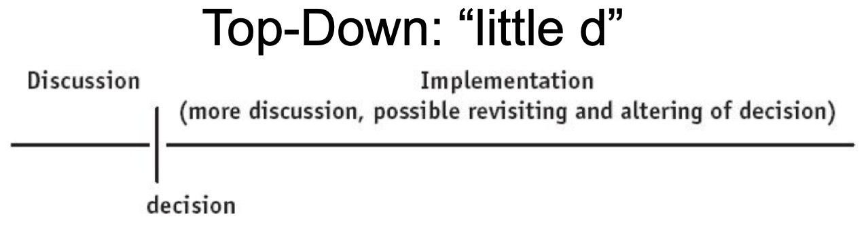
Top-down
Deciding
Discussion → decision → Change?
Individual is responsible
Slow implementation
Nigeria
China
India
Figure 5.2. The Culture Map (p. 149), by Erin Meyer, 2014, New York: PublicAffairs.
Notes:
In top-down cultures there is little discussion time before a decision is made.
Presenter notes: Click to show graph
As you can see in this graph, the decision is made quickly. Part of the reason is because an individual, not a group, makes the decision. Once a decision is made, it is a decision with a little d - as in the decision is made, but there may be several changes made before implementation.
Presenter notes: Click to remove graph.
Cultures that are top-down are Nigeria,
Presenter note: click for flag then repeat after each flag. It ends at India.
China, and India.

Slide 67
Top-down
Deciding
Boss decides
Follow the decision
Make decisions quickly
If no movement - vote
Remain flexible
Notes:
When dealing with top-down decision-making you can avoid culture clashes by doing the following:
Expect the decision-making process to be made by the boss with less discussion.
Be ready to follow a decision even if your input was not solicited or was overruled.
If you are in charge, solicit input and listen carefully to differing viewpoints, but make decisions quickly, otherwise you may be viewed as indecisive or ineffective.
When the group is divided on how to move forward and there is no obvious leader present, suggest a vote. All members are expected to follow the decision supported by the majority, even if they disagree.
Remain flexible. Decisions are rarely set in stone. Most decisions can be adjusted, revisited, or discussed again.

Slide 68
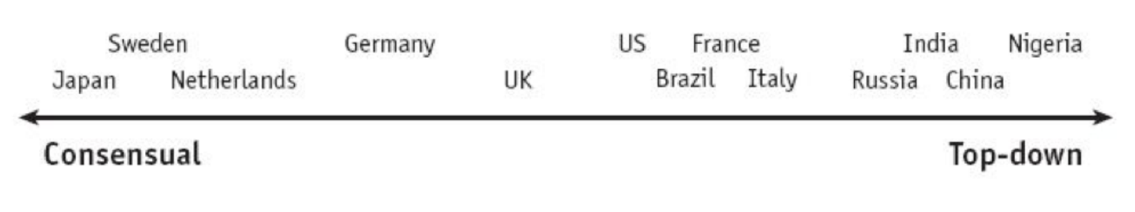
Deciding
Deciding
Figure 4.1. Leading. The Culture Map (p. 125), by Erin Meyer, 2014, New York: PublicAffairs.
Figure 5.3. Deciding. The Culture Map (p. 150), by Erin Meyer, 2014, New York: PublicAffairs.
Notes:
Most cultures that are egalitarian are consensual and top-down are hierarchical.
Presenter notes: Click to show next graph
But as you can see here, the United States, Germany, and Japan are outliers. The United States is egalitarian but is top-down when it comes to decision-making. Whereas German and especially Japan, are more hierarchical but are consensual when it comes to decision-making.

Slide 69
Decision-making
Deciding
Choose a method
Vote or boss
Deadline
Flexibility
Notes:
When dealing with multicultural decision-making, you can avoid problems by discussing and agreeing on a decision-making method early on.
Other things to consider - will the decision be made by the vote or the boss? What does percentage agreement is needed - 100%? Is a deadline for the decision needed and if so, when is it? And how much flexibility is there to change the decision once it is made?

Slide 70
Activity - Deciding
Deciding
Figure 5.3. Deciding. The Culture Map (p. 150), by Erin Meyer, 2014, New York: PublicAffairs.
Nigeria
Germany
Notes:
For this activity, we are going to compare two cultures and discuss what conflict may arise due to the different deciding styles.
Presenter note: click to reveal flags.
Pretend you are a Nigerian meeting with a German company. How would the decision-making process differ? What could frustrate you when dealing with the German decision-making process.
Presenter note: Give time for a discussion. You should hear answers like:
The decision-making process takes longer. There are more meetings. Everyone has a say. Once a decision is made, it cannot be changed. Once the discussion has died down, ask the following:
Now what would you do to make sure you can make the decision-making process a smoother one?
You should hear answers like:
Be patient throughout the process, even when diverging opinions lead to seemingly interminable discussions and indecision.
Check in with counterparts regularly to show your commitment and be available to answer questions.
Cultivate informal contacts within the team to monitor where the team is in the decision-making process.
Focus on the quality and completeness of the information gathers and the soundness of the reasoning process. Remember, once a decision is made, it will be difficult to change it.

Slide 71
Activity - Deciding
Deciding
Figure 5.3. Deciding. The Culture Map (p. 150), by Erin Meyer, 2014, New York: PublicAffairs.
Sweden
Russia
Notes:
Now pretend you are a Swede meeting with a Russian company. How would the decision-making process differ? What could frustrate you when dealing with the Russian decision-making process.
Presenter note: Give time for a discussion. You should hear answers like:
The decision is made quickly. An individual makes the decision. Once the decision is made, there may be several changes made before implementation.
Now what would you do to make sure you can make the decision-making process a smoother one?
You should hear answers like:
Expect the decision-making process to be made by the boss with less discussion.
Be ready to follow a decision even if your input was not solicited or was overruled.
If you are in charge, solicit input and listen carefully to differing viewpoints, but make decisions quickly, otherwise you may be viewed as indecisive or ineffective.
When the group is divided on how to move forward and there is no obvious leader present, suggest a vote. All members are expected to follow the decision supported by the majority, even if they disagree.
Remain flexible. Decisions are rarely set in stone. Most decisions can be adjusted, revisited, or discussed again.

Slide 72
Summary
Deciding
Consensual
Top-down
Notes:
In this module, we learned that some cultures decide through consensus with many people involved in the process. When a decision is made it is final.
In top-down cultures, an individual makes the decision, but that decision is flexible.
Most cultures that are egalitarian are consensual and top-down are hierarchical.

Slide 73
Trusting
Notes:
Erin Meyer wrote, “Trust is like insurance - it’s an investment you need to make up front, before the need arises.”

Slide 74

Styles of trust
Trust
Notes:
Let’s start with a video clip of Erin Meyer talking about trust.

Slide 75

Styles of trust
Trust
Task-based (Cognitive)
Relationship-based (Affective)
Notes:
As Erin mentioned, there are two cultural styles of trust - task-based or cognitive, and relationship-based or affective.

Slide 76
Task-based
Trust
Head/Cognitive
Based on confidence
Interactions
Relationships built and dropped
Icebreakers
United States
Denmark
Netherlands
Australia
Notes:
Task-based cultures use head or cognitive trust. This trust is based on the confidence you feel in another person’s accomplishments, skills, and reliability. This trust is built through business interactions. To gain their trust you have to do your work well, and demonstrate through the work that you are reliable, pleasant, consistent, intelligent, and transparent.
Work relationships are built and dropped easily. Once you are done working with someone, you are do not necessarily continue the relationship.
Task-based cultures will do activities like icebreakers to get to know each other. But once the icebreaker is done, it is checked off the list of things to do and then the relationship formed is quickly dropped.
Cultures that are task-based are the United States,
Presenter note: click for flag then repeat after each flag. It ends at Australia.
Denmark, The Netherlands, and Australia.

Slide 77
Relationship-based
Trust
Heart/Affective
Based on closeness
Relationships built slowly
Going out
Nigeria
Saudi Arabia
India
China
Notes:
Relationship-based cultures use heart or affective trust. This trust is based on feelings of emotional closeness, empathy, or friendships. They believe “We laugh together and see each other at a personal level, so that I feel affection or empathy for you and sense you feel the same.”
Work relationships are built up slowly over long term with meals, evening drinks, and visits at the coffee machine.
Cultures that are relationship-based are Nigeria,
Presenter note: click for flag then repeat after each flag. It ends at China.
Saudi Arabia, India, and China.

Slide 78
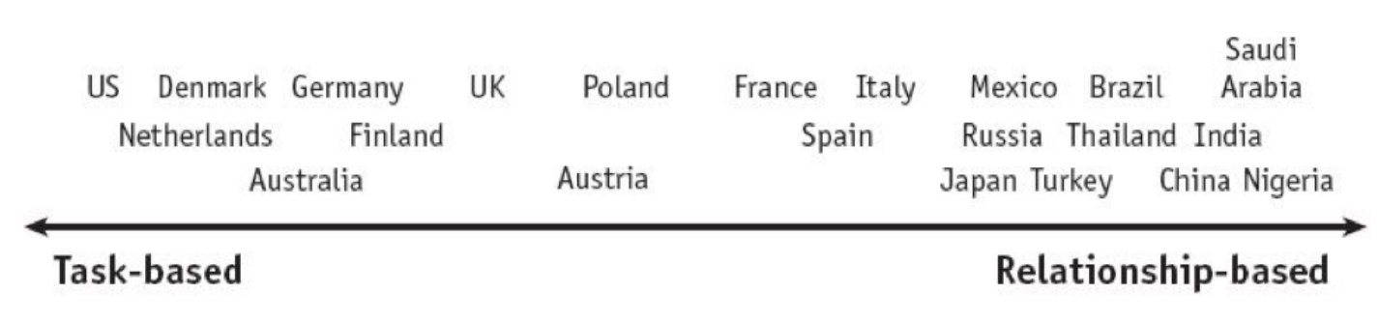
Trust
Trust
Figure 6.1. Trusting. The Culture Map (p. 171), by Erin Meyer, 2014, New York: PublicAffairs.
Notes:
Here is a graph that shows where cultures fall on the trust scale. Remember that where cultures lie on the scale affect how they are seen by others on the scale. Australia may be task-based, but not as much as the United States, but more so than the UK. Turkey may be relationship-based but not as much as China, but more so than Japan.
But, no matter who you are, working with, investing more time in building relationship-based trust is a good idea.

Slide 79

Build on common interests
Trust
Similarities
Research
Notes:
One way to gain trust, especially in relationship-based cultures, is to build on common interests. Here’s one of Erin’s stories from her book.
A man from Austria had spent months trying to close a deal in Russia with presentations and brochures, but nothing was working. He asked a colleague to intervene. This colleague went to visit the client. He noticed the Russian was about his age, so he asked him about his family and grandchildren. They spoke for a while about that. Then noticing the model of a fighter plane on his desk, the colleague then started talking about planes, bringing up his experience in the military. Later, the Russian client and his wife took the colleague to the ballet that evening. In less than 24 hours, the Russian signed a contract with the Austrian business.
Don’t have anything in common or cannot meet in person? An Italian working with people from India spent a couple of hours listening to Indian Pop music. When speaking with his team in India, he shared with them what he had been listening to. They teased him that it was teenaged-girl music, and sent him other music to listen to. It opened up a relationship, leading to trust.

Slide 80
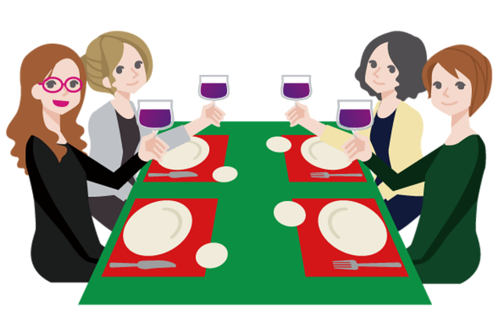
Show your true self
Trust
Relax
No business
Notes:
In task-based societies, people remain professional when going out for dinner or drinks after work. In relationship-based societies, this can lead to distrust because you are not being yourself.
So forget business after hours. Show your true self. In Japan they use drinking to form connections. It is known as “nomunication.” The more you are willing to remove social barriers in the evening, the more they will see you as trustworthy. If you don’t drink, find another way to bind - like with karaoke or over tea.

Slide 81
Consider meals carefully
Trust
Task-based hosting Relationship-based
  Spend more time organizing meals
Relationship-based hosting Task-based
  One hour lunch
Notes:
If a task-based culture is hosting a relationship-based culture, then more time and effort should be made in organizing the meals. During meals, spend time getting to know each other personally rather than conducting business. Don’t mistake a long lunch as a waste of time.
On the other hand, if a relationship-based cultures is hosting a task-based culture, organize a one hour lunch. If the meal needs to be longer, explain this in advance. And don’t be offended if your task-based colleague wants to go back to the hotel instead of socializing after work.

Slide 82

Phone, email, or wasta
Trust
Task-based
  Email
  Phone
Relationship-based
  Call
  Wasta
Let them lead
Notes:
What is the most efficient communication medium for the different culture-types?
With task-based cultures, if you can’t visit in person, email or phone is best as long as the message is communicated clearly and succinctly.
In some relationship-based cultures, people don’t often respond to emails from people they don’t know. So it is better to visit in person. But if you can’t visit and have to call or email, use a “wasta.” In Arabic “wasta” translates loosely to “connections that create preference,” “relationships that give you influence,” or “who you know.” Use your network to find a wasta - someone you know who has a relationship with the person you need to contact. They can make a call to introduce you personally. LinkedIn can also be used as a wasta or a way to find a wasta.
No matter which tool you use, think about the amount of time you will devote to social talk before business. For task-based cultures, a minute or so is all you need. For relationship-based cultures, it can be several minutes or more, with more time focused on social talk than business. In fact, your first call may not involve business at all!
When in doubt, let the other person lead and decide when to talk business.

Slide 83
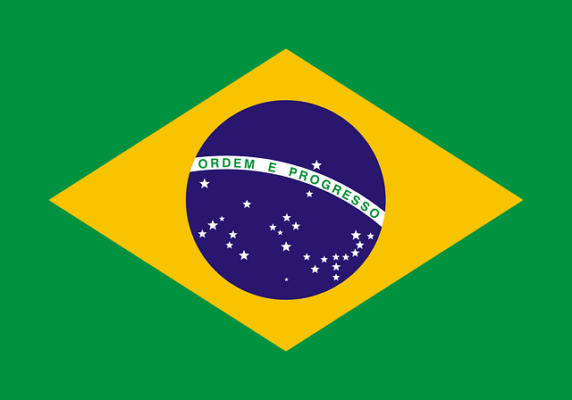
Activity - Trust
Trust
Figure 6.1. Trusting. The Culture Map (p. 171), by Erin Meyer, 2014, New York: PublicAffairs.
The Netherlands
Brazil
Notes:
How would you gain trust with these cultures?
Presenter note: Click to reveal the country
You are from the Netherlands and you want to gain the trust of a colleague in Brazil. What should you do?
Presenter note: Give time for a discussion. You should hear answers like:
Find common interests, go out after work but don’t talk business, show your true self, etc.

Slide 84
Activity - Trust
Trust
Figure 6.1. Trusting. The Culture Map (p. 171), by Erin Meyer, 2014, New York: PublicAffairs.
Thailand
Australia
Notes:
How would you gain trust with these cultures?
Presenter note: Click to reveal the country
Now pretend you are from Thailand and you want to gain the trust of a colleague in Australia. What should you do?
Presenter note: Give time for a discussion. You should hear answers like:
One-hour lunches, don’t be offended if they want to go back to their hotel, get to the point, etc.

Slide 85
Summary
Trust
Task-based
Relationship-based
Notes:
In this module, we learned that task-based cultures build trust based on your accomplishments whereas relationship-based cultures build trust based on your true self.

Slide 86
Disagreeing
Notes:
Are you the kind of person who likes a spirited debate or does a spirited debate give you nightmares?

Slide 87
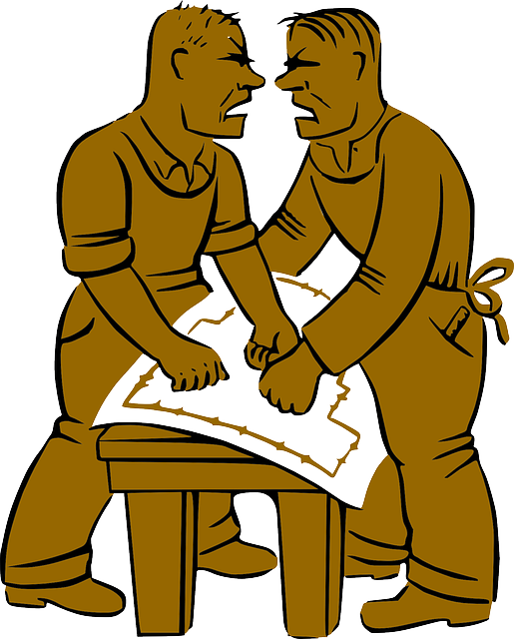
Styles of disagreement
Disagreeing
Confrontational
Avoids confrontation
Notes:
There are two cultural styles of disagreement - confrontational and avoids confrontation.

Slide 88
Confrontational
Disagreeing
Disagreement and debate are positive
Open confrontation is appropriate
No negative impacts to a relationship
Israel
Germany
France
Notes:
In confrontational cultures, disagreement and debate are positive for the team or organization.
Open confrontation is appropriate and will not negatively impact relationships.
Cultures that are more confrontational include Israel,
Presenter note: click for flag then repeat after each flag. It ends at France.
Germany and France.

Slide 89
Avoids Confrontation
Disagreeing
Disagreement and debate are negative
Open confrontation is inappropriate
Negatively impacts a relationship
Japan
Indonesia
Thailand
Notes:
In cultures that avoid confrontation, disagreement and debate are negative for the team or organization.
Open confrontation is inappropriate and will break group harmony or negatively affect relationships.
Cultures that avoid confrontation include Japan,
Presenter note: click for flag then repeat after each flag. It ends at Thailand.
Indonesia, and Thailand.

Slide 90
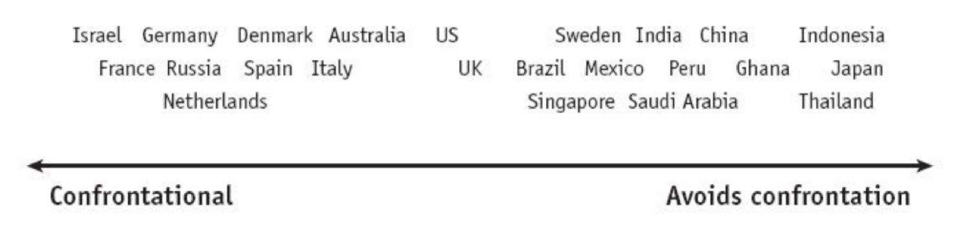
Disagreeing
Disagreeing
Figure 7.1. Disagreeing. The Culture Map (p. 201), by Erin Meyer, 2014, New York: PublicAffairs.
Notes:
Some may find it odd that cultures that are considered emotionally expressive, like Mexico or Saudi Arabia are on the “avoids confrontation” part of the scale, while northern European cultures that are considered reserved, like the Netherlands, Denmark, or Germany are considered confrontational.
But emotional expressiveness is not the same thing as comfort in expressing open disagreement.

Slide 91
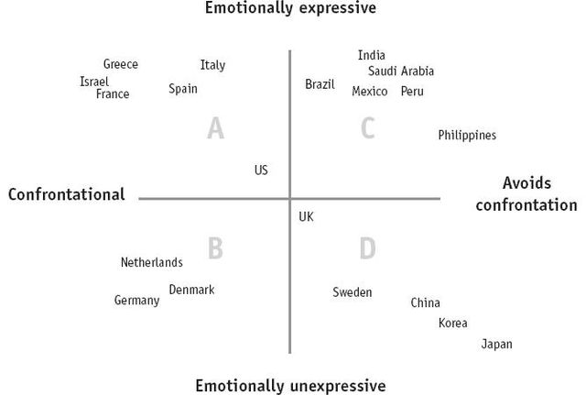
Disagreeing
Figure 7.3. The Culture Map (p. 204), by Erin Meyer, 2014, New York: PublicAffairs.
Notes:
Here we see the disagreeing scale mapped against the emotionally expressive scale.
Quadrants A and D are pretty straightforward. In quadrant A, emotions are poured out with little likelihood of relationships being harmed. In quadrant D, however, emotions are expressed more subtly and disagreements are expressed more softly.
But quadrants B and C are more complicated.
Quadrant B includes cultures that are generally NOT emotionally expressive, yet see debate and disagreement as a critical step to the truth.
Quadrant C includes cultures that speak with passion, yet are sensitive and easily bruised. It is not easy to separate the opinion from the person. Remember in these cultures that speaking with passion is NOT the same as disagreeing.

Slide 92
Getting global teams to disagree agreeably
Disagreeing
Skip the meeting
Separate ideas from person
Meet before the meeting
Adjust your language
Notes:
If you are the boss of a global team, consider skipping the meeting. Depending on cultures involved, your seniority may impact the comfort of others to disagree with you.
Depersonalize disagreement by separating ideas from the people proposing them. One way to do this is have people anonymously write comments on post-it notes and place them on a main board. That way it becomes easier to challenge an idea without attacking the person.
Have a meeting before the meeting to determine which of the following methods you will use for meetings:
A decision is made in the meeting.
Various viewpoints are discussed and debated.
A formal stamp is put on a decision that has been made before the meeting.
Adjust your language by using downgrades instead of upgrades when expressing disagreement. Use downgraders like “sort of,” “kind of,” “slightly,” or “partially.”
Overall, just a few words of explanation framing your behavior can make all the difference in how your actions are perceived.

Slide 93
Activity - Disagreeing
Disagreeing
Which is/are true about confrontational cultures?
Disagreeing can harm relationships.
Disagreement is positive for the team.
Debate is a critical step to the truth.
Notes:
Which is or are true about confrontational cultures?
Disagreeing can harm relationships.
Disagreement is positive for the team.
Debate is a critical step to the truth
Presenter note: Give a few second for people to answer then go to the next slide.

Slide 94
Activity - Disagreeing
Disagreeing
Which is/are true about confrontational cultures?
Disagreeing can harm relationships.
Disagreement is positive for the team.
Debate is a critical step to the truth.
Notes:
Both answer 2 and 3 are correct. In confrontational cultures:
Disagreement is positive for the team and Debate is a critical step to the truth.

Slide 95
Activity - Disagreeing
Disagreeing
Which is/are true about cultures that avoid confrontation?
They use upgraders to make a point.
Disagreement should be out in the open.
Confrontation can harm relationships.
Notes:
Which is or are true about cultures that avoid confrontation?
They use upgraders to make a point.
Disagreement should be out in the open.
Confrontation can harm relationships.
Presenter note: Give a few second for people to answer then go to the next slide.

Slide 96
Activity - Disagreeing
Disagreeing
Which is/are true about cultures that avoid confrontation?
They use upgraders to make a point.
Disagreement should be out in the open.
Confrontation can harm relationships.
Notes:
In these cultures, confrontation can harm relationships. Open confrontation is inappropriate and will break group harmony or negatively affect relationships.

Slide 97

Disagreeing
Disagreeing
“To engage in conflict, one does not need to bring a knife that cuts, but a needle that sews.” - Bahamian proverb
Notes:
Let’s end this module with a Bahamian proverb - “To engage in conflict, one does not need to bring a knife that cuts, but a needle that sews.”

Slide 98
Summary
Disagreeing
Confrontational
Avoids confrontation
Emotionally expressive is not necessarily disagreement
Notes:
In confrontational cultures, disagreement and debate are positive for the team or organization.
In cultures that avoid confrontation, disagreement and debate are negative for the team or organization.
Remember, just because a culture is emotionally expressive does not mean they disagree.

Slide 99
Scheduling
Notes:
How late is late to you? One minute? Ten minutes? An hour?
Understanding the subtle, often unexpressed assumptions about time that controls behaviors and expectations in various cultures can be quite challenging.

Slide 100

Scheduling
Scheduling
Linear-time
Flexible-time
Notes:
There are two cultural styles of scheduling - linear-time and flexible-time.

Slide 101

Linear-time
Scheduling
Projects are sequential
One thing at a time
No interruptions
Focus on deadline and schedule
Prompt and organized
Germany
Switzerland
Japan
Sweden
Notes:
In cultures where they use linear-time, project steps are approached in a sequential fashion where tasks are completed one at a time, before completing the next. If someone is 5 minutes late on the factory floor, it affects everyone else’s time an tasks.
There are no interruptions in meetings. The focus is on the deadline and sticking to a schedule.
The emphasis is placed on promptness and good organization over flexibility.
Cultures that are linear include Germany,
Presenter note: click for flag then repeat after each flag. It ends at Sweden.
Switzerland, Japan, and Sweden.

Slide 102
Flexible-time
Scheduling
Projects are fluid
Many things at once
Interruptions
Focus on adaptability
Flexibility over organization
Nigeria
Saudi Arabia
Kenya
India
Notes:
In cultures where they use flexible-time, project steps are approached in a fluid manner - changing tasks as opportunities arise.
Many things are dealt with at once and interruptions are accepted.
The focus is on adaptability and flexibility is valued over organization.
Cultures that are linear include Nigeria,
Presenter note: click for flag then repeat after each flag. It ends at India.
Saudi Arabia, Kenya, and India.

Slide 103
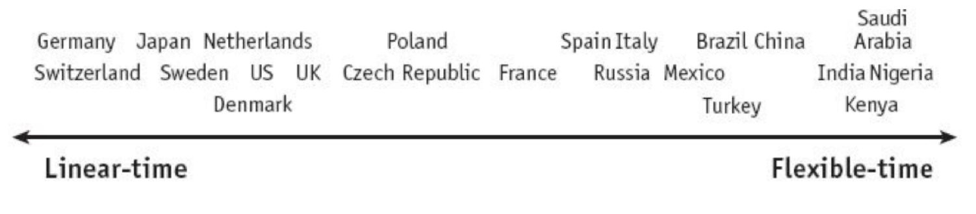
Scheduling
Scheduling
Figure 6.1. Trusting. The Culture Map (p. 171), by Erin Meyer, 2014, New York: PublicAffairs.
Figure 7.1. Disagreeing. The Culture Map (p. 201), by Erin Meyer, 2014, New York: PublicAffairs.
Notes:
If relationships are a priority, you will put them before the clock. Cultures that put them a premium on relationship-building, with a few exceptions, fall on the flexible time side of the scheduling table.
Let’s compare the relationship-based with flexible-time. India, Saudi Arabia, and Nigeria are close to the same position in both scales.

Slide 104
Scheduling conflicts
Scheduling
Discuss up front
Follow team culture
Revist and adapt
Notes:
When dealing with conflicting scheduling cultures, have a clear discussion about scheduling systems up front. It can ease frustration that may pop up.
Groups can form an agreement that follows its own team culture instead of allowing members to follow the methods most natural in their culture. The team leader will need to reinforce what the group has agreed to and set aside time to revisit the agreement about twice a year, making any adaptations necessary.

Slide 105
Activity - Scheduling
Scheduling
Which are linear-time and which are flexible-time?
Many topics are discussed at once.
The focus is on adaptability.
There are no interruptions in meetings.
Project steps are approached in a fluid manner.
Notes:
Let’s do an activity. Which are linear-time and which are flexible-time?
Presenter note: Give participants time to answer before going to the next slide.

Slide 106
Activity - Scheduling
Scheduling
Which of the following are linear-time or flexible-time?
Many topics are discussed at once. - Flexible-time
The focus is on adaptability. - Flexible-time
There are no interruptions in meetings. - Linear-time
Project steps are approached in a fluid manner. - Flexible-time
Notes:
In flexible-time, many topics are discussed at once, the focus is on adaptability, and project steps are approached in a fluid manner. Whereas in linear-time, there are no interruptions in meetings. Things follow a strict timeline.,

Slide 107
Summary
Scheduling
Linear-time
Flexible-time
Notes:
In this module, we learned that cultures that follow linear-time, project steps are approached in a sequential fashion where tasks are completed one at a time, before completing the next. Being on time is stressed.
Whereas cultures that put them a premium on relationship-building, with a few exceptions, fall on the flexible time side of the scheduling table.

Slide 108
Conclusion
Notes:
So what do you do with all of this information? You can try plotting your own map!

Slide 109
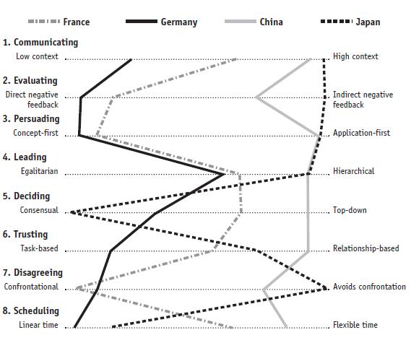
Eight scales
Conclusion
Communication
Evaluating
Persuading
Leading
Deciding
Trusting
Disagreeing
Scheduling
Notes:
To use the Culture Map, plot your culture using the eight scales.
Presenter note: Click to show graph.
Then map your business partners’ to see where they compare.
Noting points of similarity and difference will help you recognize the fault lines that may be dividing your team members. This will also allow you to be better able to act as a cultural bridge.
Look not only at the difficulties that arise from gaps, but the strengths and the differences provide.

Slide 110

Conclusion
Notes:
However, no matter who you are working with or where that person comes from, you should begin any relationship with the desire to understand what is specific and unique to that individual. Don’t assume that you can determine anything specific about how they will think or behave from what you know about their cultural background.

Slide 111
The Culture Map
Training from the book by Erin Meyer
Notes:
Thanks for participating! What we covered in this presentation is just a small part of what Erin Meyer covers in “The Culture Map.” Dive into her book to learn more about how we can work with cultures different than ours. Also read personal stories and experiences from people all over the world.

